Slide 1

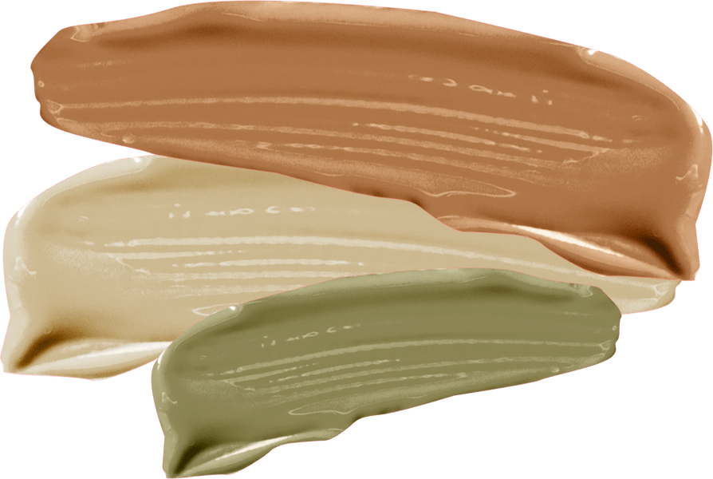
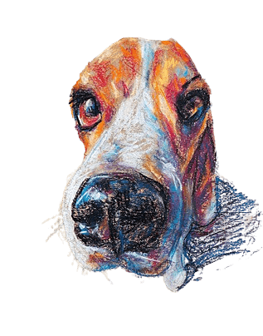


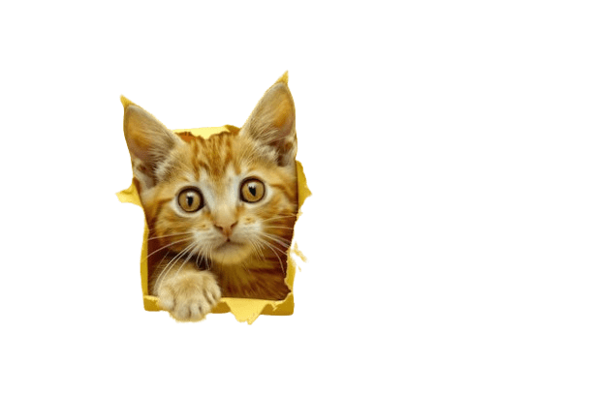

PET VERSE: VIRTUAL PET ADOPTION & BUYING PLATFORM. ENHANCED WITH AR, VR, AND GAMIFICATION
ONE FOR ALL

Slide 2





OUR TEAM
RITHIKA H
RAHUL S
RISHI R L
SWATHY C

Slide 3


PROJECT STATEMENT
Many people yearn for the companionship of pets but face practical limitations like allergies, small living spaces, or busy schedules that make traditional pet ownership challenging. While virtual pet apps exist, they often lack depth and realistic interaction, leaving users unsatisfied. Additionally, technologies such as Augmented Reality (AR) and Virtual Reality (VR) that could create a more immersive experience are largely untapped in this space. As a result, people seeking an engaging and emotionally rewarding pet interaction are left with few suitable options.

Slide 4


SOLUTION
An innovative virtual pet adoption platform that provides an immersive, lifelike pet ownership experience.
•Key Components:
•Augmented Reality (AR): Integrate virtual pets into real-world settings.
•Virtual Reality (VR): Experience pet care in fully immersive virtual environments.
•Gamification: Engage users with rewards, achievements, and interactive pet care tasks.

Slide 5
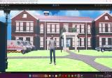
KEY FEATURES OF PET VERSE:
• AR and VR Integration:
•AR: Bring virtual pets into the real world with mobile devices.
•VR: Create a fully immersive environment for a realistic pet experience.
•Gamified Interactions:
•Earn rewards and achievements for completing pet care activities.
•Progress levels, unlock new items, and earn badges.
•Customization Options:
•Choose pet species, breeds, appearance, and behavior to fit user preferences.

Slide 6


USER JOURNEY
Registration and Onboarding:
•Quick setup and tutorial on pet care essentials in a virtual setting.
Pet Selection and Customization:
•Choose and personalize pets to match preferences in breed, color, and personality with the help of pop ups .
Interactive Pet Care:
•Use AR to bring pets into real spaces or VR to explore virtual pet with the clinic setup ,play areas and homes.
Gamified Engagement and Rewards:
•Progress through levels and unlock new activities and accessories.

Slide 7




TECHNICAL
ARCHITECTURE
Platform Components:
•AR Module: Mobile-friendly interface for real-world pet interactions.
•VR Environment: Immersive spaces for VR headset users.
•Game Engine: Unity to support interactive pet experiences.
Backend:
•C# for the pop ups which deliver information of the pet.

Slide 8
TECHNOLOGY STACK
•AR Development: ARCore (Android).
•VR Support: Compatible with Oculus and other VR headsets.
Game Engine: Unity for high-quality graphics and interactions

Slide 9
COMPETITIVE ADVANTAGES & FUTURE ENHANCEMENTS
•Immersive Experience: Realistic pet interaction via AR and VR.
•Emotional Connection: Personalized pet behaviors that adapt to user interactions.
•Scalability: Easily expand with new pet types, environments, and features.
•Community Building: Fosters a community of pet lovers who can connect and share experiences.
AI-Driven Personalities:
•Develop AI-based pet personalities that adapt based on interactions and user preferences.
•Expanded Community Features:
•Virtual playdates, competitions, and social features for a community-driven experience.
Real-World Integration:
•Collaboration with pet shelters or stores for users interested in real pet adoption.
Platform Expansion:
•Broaden platform compatibility to include consoles and newer VR devices.

Slide 10

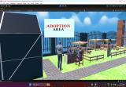
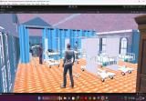
DOCUMENTATION
•Pet Verse combines AR, VR, and gamification to provide a unique, immersive pet ownership experience accessible to anyone.
•Creates emotional and engaging interactions, revolutionizing how users experience virtual pets.

Slide 11
THANK YOU
BY: TEAM ONE FOR ALL

